Slide 1
Investigating the Psychometric Properties of the Values Wheel with a Clinical Cohort: A Preliminary Validation Study
Kate Barrett, Martin O’Connor, & Louise McHugh, Ph.D
University College Dublin

Slide 2
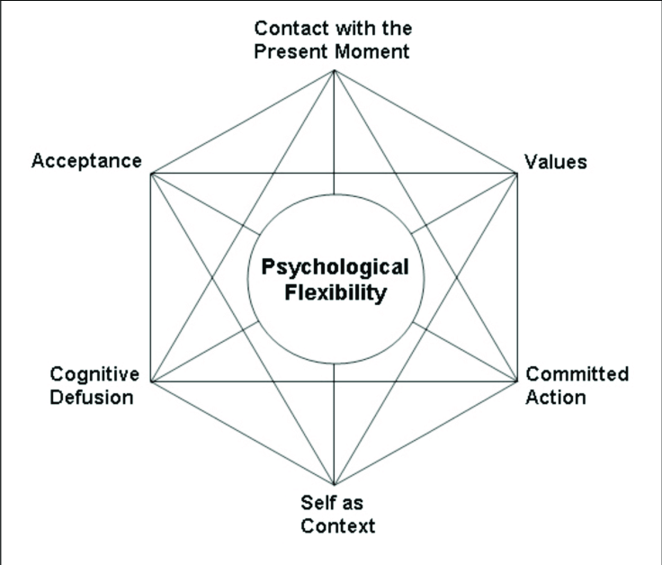
Why bother?
Notes:
Measures of values arose out of a need to accurately measure outcomes on each of the distinct processes within Acceptance and Commitment Therapy (ACT). ACT comprises acceptance, defusion, contact with the present moment, self-as-context, values and committed action, which together foster psychological flexibility.

Slide 3
Why bother?
Notes:
Values are important because the core aim of ACT as a therapy is to encourage individuals to be more aware and accepting of their thoughts, feelings and bodily sensations. However, this is not done for its own sake, but rather in order to allow them to pursue a life that is more personally meaningful to them. I.e. in line with their own particular values.

Slide 4

Values
Notes:
Laymans: Qualities that we bring to our actions on an ongoing basis, which are freely chosen, based on their subjective importance.
Values provide a sense of meaning, purpose and vitality, as well as generating a sustained motivation for following behavioral pursuits

Slide 5
Measuring Values
Notes:
Many previous studies have focused on the development and validation of values measures; however few of these have validated measures with a clinical cohort, in spite of these people often being the primary recipients of psychological interventions. Equally, many measures focused on either the process of “valued-living”, or the identification of values according to pre-defined domains (e.g. “family” “Work” etc.).

Slide 6
Measuring Values
Notes:
In contrast, the values wheel is an idiographic measure of values. A previous validation study suggested the VW demonstrated evidence for the construct, convergent and criterion-related validity, as well as supporting its temporal reliability. The values wheel also has not been validated for use with a clinical population.

Slide 7
Values Wheel
Notes:
The values wheel comprises five coloured discs, which are mounted to a backing disc. Each of the five adjustable, interlocking discs feature a target ranging from 0-100, divided into 10 increments of 10mm. The backing disc consists of 100 equally divided segments. Therefore, similar to a pie-chart, the coloured discs can be moved in order to reflect the relative weighting of each disc (ranging between 0-100). Participants are requested to write a personally-selected value on the lip of each disc, and subsequently rate the degree to which their behaviour has been consistent with each value during the previous week. This is done by marking the target of the respective coloured disc for each value. Finally, the area of the pie-chart ascribed to each value is adjusted until it reflects the relative importance of each value for the participant. Scores on the VW are computed by multiplying target rating × weight, and summing the outcomes to deliver a composite rating of values-directed behaviour.

Slide 8
Values Wheel
Notes:
It aims to provide a tactile, idiographic, weighted index of values-directed behaviour, which functions across both contexts and languages, hence both minimising the costs of translation (Beaton, Bombardier, Guillemin, & Ferraz, 2000) and providing an alternative assessment format for clients with prior negative experiences of questionnaires (O’Connor et al., in press). The VW may therefore offer an incremental advancement on aspects of existing values measures.

Slide 9
Values Wheel
Notes:
It aims to provide a tactile, idiographic, weighted index of values-directed behaviour, which functions across both contexts and languages, hence both minimising the costs of translation (Beaton, Bombardier, Guillemin, & Ferraz, 2000) and providing an alternative assessment format for clients with prior negative experiences of questionnaires (O’Connor et al., in press). The VW may therefore offer an incremental advancement on aspects of existing values measures.

Slide 10
Values Wheel
Notes:
It aims to provide a tactile, idiographic, weighted index of values-directed behaviour, which functions across both contexts and languages, hence both minimising the costs of translation (Beaton, Bombardier, Guillemin, & Ferraz, 2000) and providing an alternative assessment format for clients with prior negative experiences of questionnaires (O’Connor et al., in press). The VW may therefore offer an incremental advancement on aspects of existing values measures.

Slide 11

Aims
To examine the psychometric robustness of the Values Wheel with an adult clinical cohort by examining its construct, discriminant, convergent and incremental validity.

Slide 12
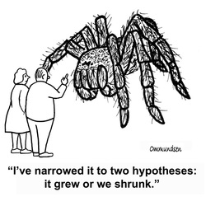
What we predicted…
Notes:
Made a number of formal hypotheses about how we expected scores on the values wheel to relate to other constructs (e.g. that it would positively relate to outcomes on positive global, social, psychological and emotional well-being, as well as life satisfaction, and negatively relate to outcomes on stress, anxiety, depression and psychological inflexibility). We also predicted that VW scores would be unrelated to theoretically unrelated variables (e.g. age, years of education and social desirability), and would add to the amount of variance in predicting outcomes on well-being, above and beyond psychological flexibility alone. Furthermore, it was expected that scores on the VW would be positively correlated with scores on other existing values measures.

Slide 13
What we predicted…
Notes:
Made a number of formal hypotheses about how we expected scores on the values wheel to relate to other constructs (e.g. that it would positively relate to outcomes on positive global, social, psychological and emotional well-being, as well as life satisfaction, and negatively relate to outcomes on stress, anxiety, depression and psychological inflexibility). We also predicted that VW scores would be unrelated to theoretically unrelated variables (e.g. age, years of education and social desirability), and would add to the amount of variance in predicting outcomes on well-being, above and beyond psychological flexibility alone. Furthermore, it was expected that scores on the VW would be positively correlated with scores on other existing values measures.

Slide 14

What we did…
51 adult clients who were actively engaged with primary or secondary mental health services within the Health Service Executive.
Ages varied between 19 and 73 years (M = 42 years, SD = 13.32). 71% identified as female.
Client presentations included anxiety (20%), depression (22%), comorbid anxiety and depression (31%), eating disorders (2%), substance abuse (6%), obsessive compulsive disorder (4%), mental health issues comorbid with a history of psychosis (4%) and mixed presentations (11%).
Notes:
51 adult clients recruited through mental health services and presented with a variety of mental health issues. Completed questionnaires and values wheel with them in person in order to manage any risks associated, and complete risk assessment. Unfortunately lead to small sample size.

Slide 15
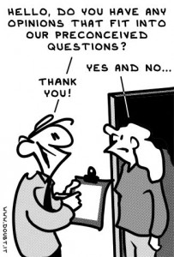
What we did…
Notes:
Completed questionnaire battery examining global, social, psychological and emotional well-being, stress, anxiety and depression, life satisfaction, social desirability, values and psychological flexibility. Finished with the values card sort, during which clients chose what values mattered to them, e.g. “acceptance”, “compassion”, and completed the values wheel.

Slide 16

What we found…
Construct validity was supported, with seven out of nine hypotheses demonstrating correlations in the expected directions.
Results partially supported the discriminant validity of the Values Wheel.
Evidence was found for both the convergent and incremental validity of the Values Wheel.
Notes:
Higher scores on the Values Wheel were positively related to global, social, emotional and global well-being, life satisfaction, as well as anxiety and stress (contrary to hypotheses). Values Wheel scores were negatively correlated with depression and psychological inflexibility. (While the relationship between VW scores and two subscales of the DASS (anxiety and stress) were not in line with hypotheses, it had been noted that such outcomes were more likely to vary independent of outcomes on values measures, as emotional and affective states are not expected to directly align with values-consistent behaviour)
No significant effects being found between VW scores and social desirability and age, though a significant negative correlation was seen for the relationship between VW and years of education.
Convergent validity was additionally demonstrated by virtue of Values Wheel scores being positively correlated with two alternatively measures of values, in expected directions.
The VW was found to contribute to various aspects of client functioning. The greatest areas of impact were found to be emotional, psychological and global well-being, as well as overall life satisfaction

Slide 17
What we found…
Notes:
Higher scores on the Values Wheel were positively related to global, social, emotional and global well-being, life satisfaction, as well as anxiety and stress (contrary to hypotheses). Values Wheel scores were negatively correlated with depression and psychological inflexibility. (While the relationship between VW scores and two subscales of the DASS (anxiety and stress) were not in line with hypotheses, it had been noted that such outcomes were more likely to vary independent of outcomes on values measures, as emotional and affective states are not expected to directly align with values-consistent behaviour)
No significant effects being found between VW scores and social desirability and age, though a significant negative correlation was seen for the relationship between VW and years of education.
Convergent validity was additionally demonstrated by virtue of Values Wheel scores being positively correlated with two alternatively measures of values, in expected directions.
The VW was found to contribute to various aspects of client functioning. The greatest areas of impact were found to be emotional, psychological and global well-being, as well as overall life satisfaction

Slide 18


Limitations
Notes:
The main limitation of this study was the small sample size included, which may have resulted in an inability to detect smaller effects. However, it does provide preliminary evidence for the validity of the VW, and adds to existing evidence by examining this with a clinical cohort. Future studies should therefore seek larger sample sizes.

Slide 19

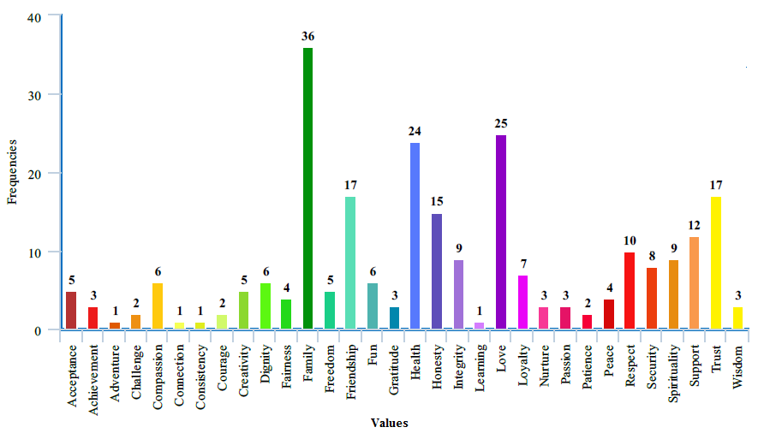
Considerations
Notes:
Though this study provides good preliminary evidence for the validity of the values wheel with a clinical sample, it should be noted that perhaps not all values available in the card sort task were consistent with the ACT conceptualization (e.g. “health”, “Family”), though these were frequently endorsed by clients. Future studies could consider amending this.

Slide 20



So what does all of this suggest?
Discriminant Validity …
Construct, Convergent and Incremental Validity ...
Reliability …
Notes:
Taken together, outcomes suggest that the Values wheel demonstrates good preliminary evidence for its construct, convergent and incremental validity. Results partially supported the discriminant validity of the VW. As the temporal stability could not be examined in this study, future research may be able to expand on the current study.

